Slide 1

Varendra University
Dept. of Computer Science & Engineering (CSE)
Lab 1
Course Title: Microprocessor and Assembly Language Lab
Course No: CSE 3206
Prepared By:
Md. Adnan Sami
Lecturer, Dept. of CSE, VU

Slide 2
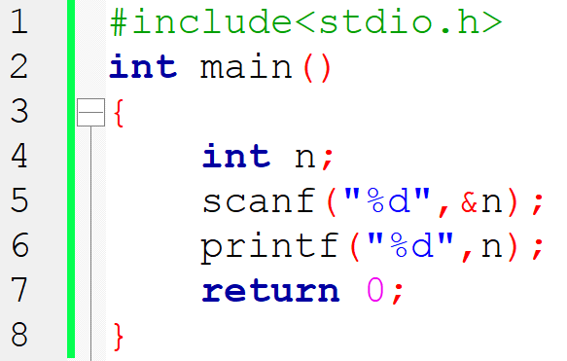

Slide 3
Register:
Data Register
AX (Accumulator Register)
BX (Base Register)
CX (Count Register)
DX (Data Register)
AX = AH AL
BX = BH BL
CX = CH CL
DX = DH DL

Slide 4
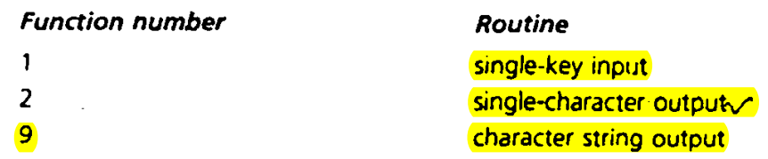
AX = AH AL
BX = BH BL
CX = CH CL
DX = DH DL
AL is reserved for input.
DL is reserved for output.

Slide 5
MOV AH, 1
Opcode
Operand
Opcode: Operation.
Operand: 2 parts,
Destination.
Source.

Slide 6
Opcode Destination, Source
MOV AH, 1
Destination
Source
Destination: The register or memory location where data is stored.
Source: Provides the data.
MOV: Used to transfer data from one location to another.

Slide 7
For Input:
mov ah,1
int 21h
mov bl,al
For Output:
mov ah,2
mov dl,bl
int 21h

Slide 8
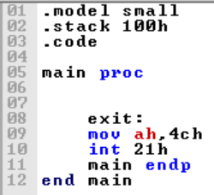
Return

Slide 9
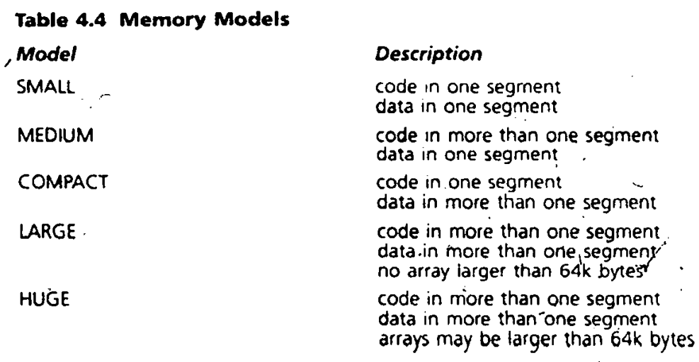

Slide 10
Experiment No: 01
Name of the Experiment:
Write an assembly language program for simple input and output using EMU8086.
Write an assembly language program for simple input and output, where the output is displayed on a new line using EMU8086.

Slide 11
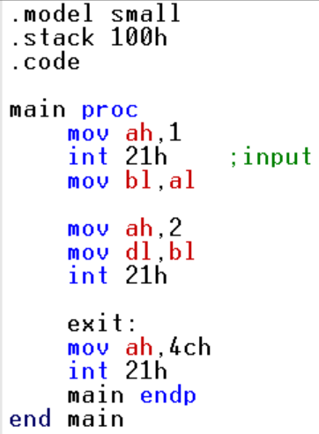
Write an assembly language program for simple input and output using EMU8086.

Slide 12
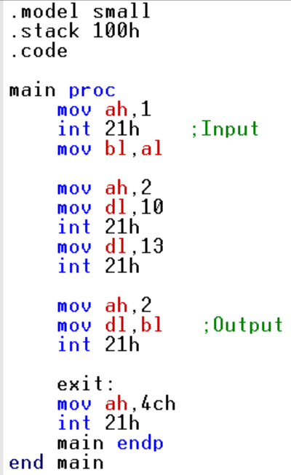
ii. Write an assembly language program for simple input and output, where the output is displayed on a new line using EMU8086.

